Slide 1
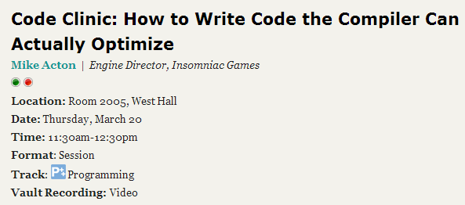
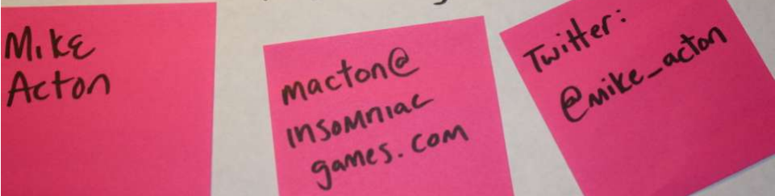
(2015)

Slide 2
I don’t know anything about wood carving, but…

Slide 3


Slide 4


Slide 5
Different problems, different scales, different tools.

Slide 6


Slide 7
Tools scale
Chainsaw
Dremel
Laser

Slide 8
Tools scale
Chainsaw
Dremel <- Compiler
Laser

Slide 9
To make best use of a tool (e.g. compiler)
Solve the part of the problem the tool can’t help with.
Prepare the area that the tool can help with.
Solve details missed by using the tool as intended.

Slide 10
Part 1: Solve the part of the problem the tool can’t help with.

Slide 11
Approaches…

Slide 12
Approach #1
Estimate resources available
Triage based on cost and value estimates
Collect data
Adapt as cost and/or value predictions change
AKA Engineering

Slide 13
Approach #2
Don’t worry about resources
Desperately scramble to fix when running out.
Generously described as irrational
Desperate scramble != “optimization”

Slide 14
The problems are there even if you ignore them.

Slide 15
Estimate resources available
What are the bottlenecks? i.e. most insufficient for the demand

Slide 16
Shell + Excel: test_0 vs. test_1 (W=2 -> W=512)

Slide 17
What can we infer?

Slide 18
33ms = 30fps
Col W=8; Ea. R/W avg +/- 32B from next/prev
8192 * 1024 * 32bit = 3MB / frame

Slide 19
33ms = 30fps
Col W=8; Ea. R/W avg +/- 32B from next/prev
8192 * 1024 * 32bit = 3MB / frame
Row, in order
8192 * 1024 * 32bit * 8.9x = 34.7MB / frame

Slide 20
W=512;
> 20x diff (1.19MB/frame)
Algorithmic complexity equivalent

Slide 21
Gap = doing nothing.

Slide 22
Why?

Slide 23
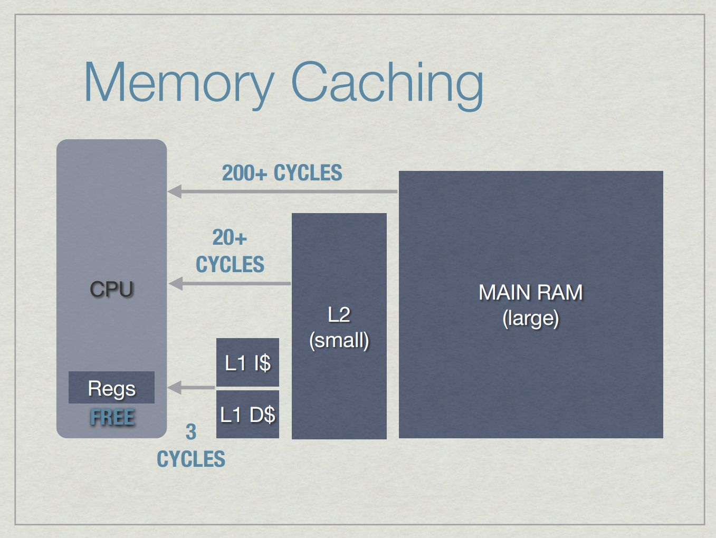
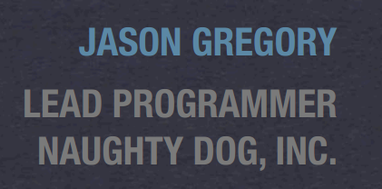
http://www.gameenginebook.com/SINFO.pdf

Slide 24
By comparison…

Slide 25

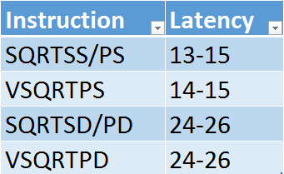
(AMD Piledriver)
http://www.agner.org/optimize/instruction_tables.pdf

Slide 26
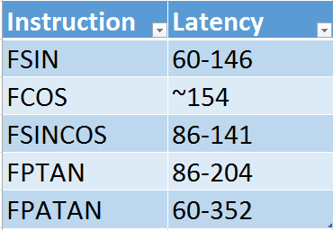
(AMD Piledriver)
http://www.agner.org/optimize/instruction_tables.pdf

Slide 27

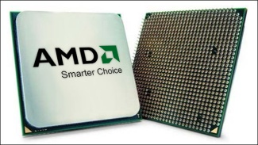
The Battle of North Bridge
L1
L2
RAM

Slide 28
Verify data…

Slide 29
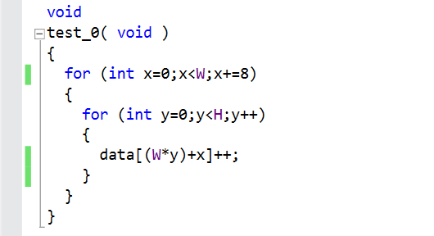

Slide 30
Excel: W=64 (int32_t; mod 8)

Slide 31
Make reasonable use of resources

Slide 32
Make reasonable use of resources
(not the same as optimization)

Slide 33
Memory access is the most significant component.

Slide 34
Bottleneck: most insufficient for the demand
Q: Is everything always all about memory access / cache?
A: No. It’s about whatever the most scarce resources are.
E.g. Disk access seeks; GPU draw counts; etc.

Slide 35
Let’s look at it another way…

Slide 36
Simple, obvious things to look for + Back of the envelope calculations = Substantial wins

Slide 37
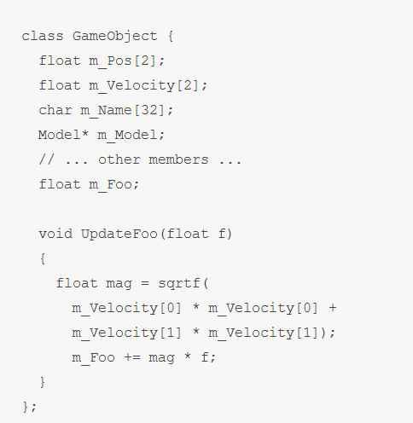
http://deplinenoise.wordpress.com/2013/12/28/optimizable-code/

Slide 38
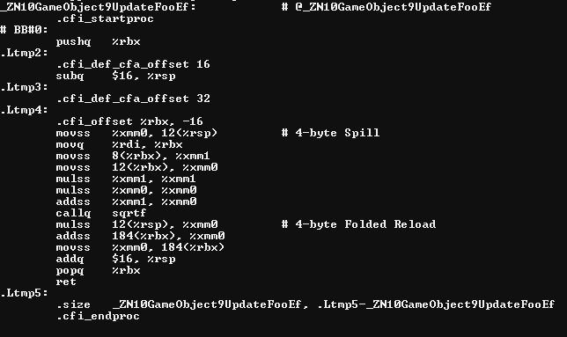

Slide 39
2 x 32bit read; same cache line = ~200

Slide 40
Waste 56 bytes / 64 bytes

Slide 41
Float mul, add = ~10

Slide 42
Let’s assume callq is replaced. Sqrt = ~30

Slide 43
Mul back to same addr; in L1; = ~3

Slide 44
Read+add from new line
= ~200

Slide 45
Waste 60 bytes / 64 bytes

Slide 46
90% waste!

Slide 47
Alternatively,
Only 10% capacity used*
* Not the same as “used well”, but we’ll start here.

Slide 48
Time spent waiting for L2 vs. actual work
~10:1

Slide 49
Time spent waiting for L2 vs. actual work
~10:1
This is the compiler’s space.

Slide 50

Time spent waiting for L2 vs. actual work
~10:1
This is the compiler’s space.

Slide 51
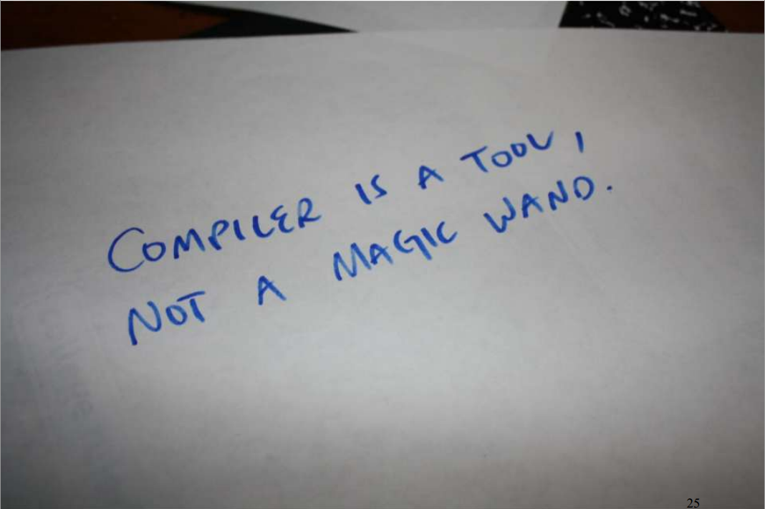
Compiler cannot solve the most significant problems.

Slide 52
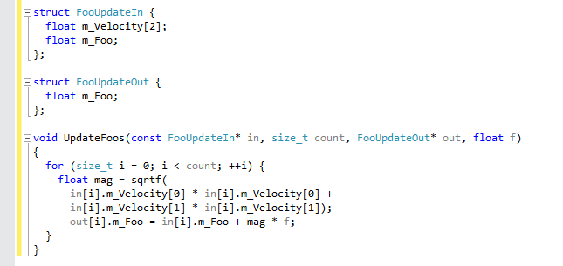

Slide 53
12 bytes x count(32) = 384 = 64 x 6
4 bytes x count(32) = 128 = 64 x 2

Slide 54
12 bytes x count(32) = 384 = 64 x 6
4 bytes x count(32) = 128 = 64 x 2
(6/32) = ~5.33 loop/cache line

Slide 55
12 bytes x count(32) = 384 = 64 x 6
4 bytes x count(32) = 128 = 64 x 2
(6/32) = ~5.33 loop/cache line
Sqrt + math = ~40 x 5.33 = 213.33 cycles/cache line

Slide 56
12 bytes x count(32) = 384 = 64 x 6
4 bytes x count(32) = 128 = 64 x 2
(6/32) = ~5.33 loop/cache line
Sqrt + math = ~40 x 5.33 = 213.33 cycles/cache line
+ streaming prefetch bonus

Slide 57
12 bytes x count(32) = 384 = 64 x 6
4 bytes x count(32) = 128 = 64 x 2
Using cache line to capacity* =
Est. 10x speedup
* Used. Still not necessarily as efficiently as possible
(6/32) = ~5.33 loop/cache line
Sqrt + math = ~40 x 5.33 = 213.33 cycles/cache line
+ streaming prefetch bonus

Slide 58
Measured = 6.8x

Slide 59
Part 2: Prepare the area that the tool can help with.

Slide 60
“The high-level design of the code generator”
http://llvm.org/docs/CodeGenerator.html
Instruction Selection
Map data/code to instructions that exist
Scheduling and Formation
Give opportunity to schedule / estimate against data access latency
SSA-based Machine Code Optimizations
Manual SSA form
Register Allocation
Copy to/from locals in register size/types
Prolog/Epilog Code Insertion
Late Machine Code Optimizations
Pay careful attention to inlining
Code Emission
Verify asm output regularly

Slide 61
“Compilers are good at applying mediocre optimizations hundreds of times.” - @deplinenoise

Slide 62
Three easy tips to help compiler
#1 Analyze one value
#2 Hoist all loop-invariant reads and branches
#3 Remove redundant transform redundancy

Slide 63
#1 Analyze one value
Find any one value (or implicit value) you’re interested in, anywhere.
Printf it out over time. (Helps if you tag it so you can find it.)
Grep your tty and paste into excel. (Sometimes a quick and dirty script is useful to convert to a more complex piece of data.)
See what you see. You’re bound to be surprised by something.

Slide 64
e.g. SoundSourceBaseComponent::BatchUpdate
if ( g_DebugTraceSoundSource )
{
Printf("#SS-01 %d m_CountSources\n”,i, component->m_CountSources);
}

Slide 65
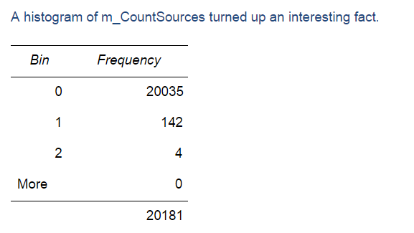

Slide 66
Approximately 0% of the sound source components have a source. (i.e. not playing yet)

Slide 67
Approximately 0% of the sound source components have a source. (i.e. not playing yet)
Switch to evaluating from source->component not component->source
20K vs. 200 cache lines

Slide 68
#2 Hoist all loop-invariant reads and branches
Don’t re-read member values or re-call functions when you already have the data.
Hoist all loop-invariant reads and branches. Even super-obvious ones that should already be in registers (member fields especially.)

Slide 69
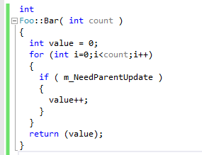
How is it used? What does it generate?

Slide 70
How is it used? What does it generate?
Equivalent to:
return m_NeedParentUpdate?count:0;

Slide 71
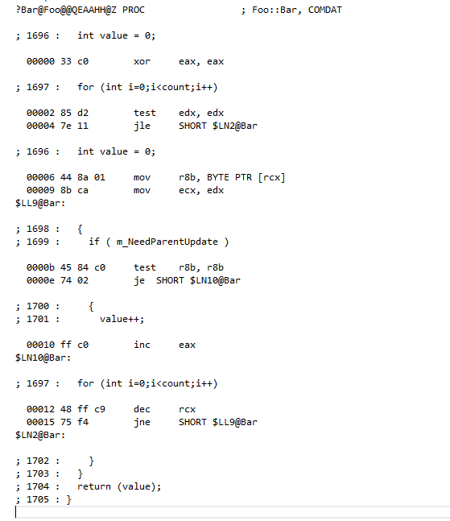
MSVC

Slide 72
MSVC
Re-read and re-test…
Increment and loop…

Slide 73

Why?
Re-read and re-test…
Super-conservative aliasing rules…?
Member value might change?
Increment and loop…

Slide 74


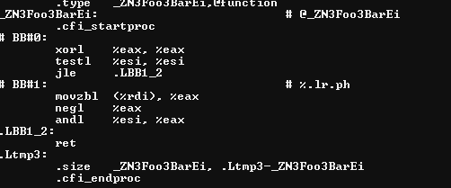
What about something more aggressive…?

Slide 75
What about something more aggressive…?
Test once and return…

Slide 76
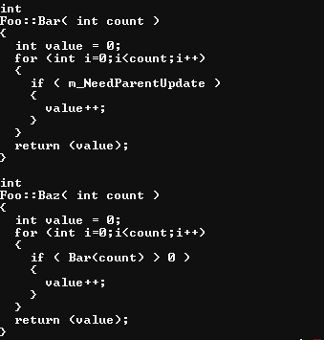
Okay, so what about…

Slide 77
Okay, so what about…
Equivalent to:
return m_NeedParentUpdate?count:0;

Slide 78
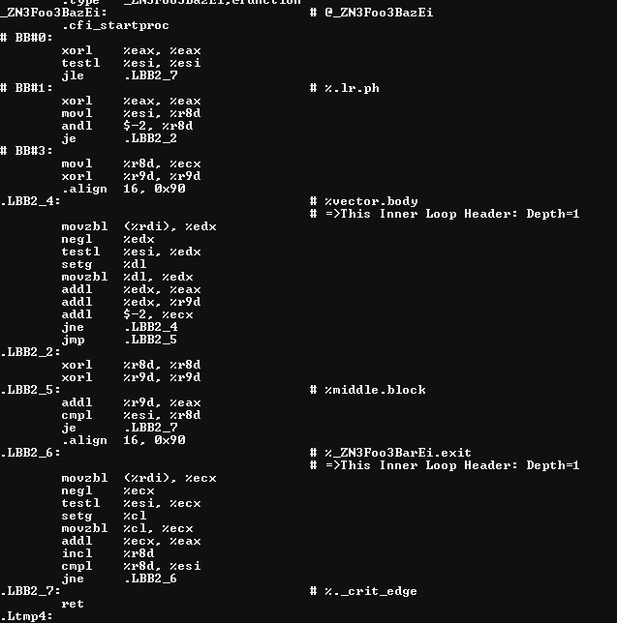
…well at least it inlined it?

Slide 79
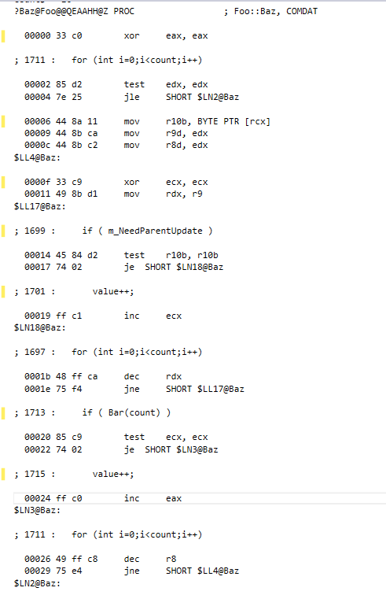
MSVC doesn’t fare any better…

Slide 80
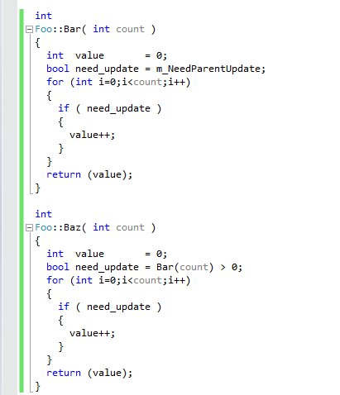
Ghost reads and writes
Don’t re-read member values or re-call functions when
you already have the data.

Slide 81
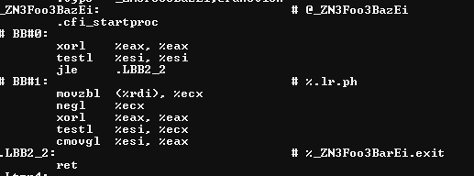
BAM!

Slide 82
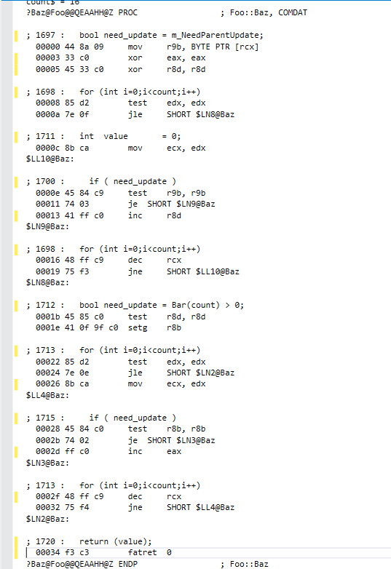
:(

Slide 83
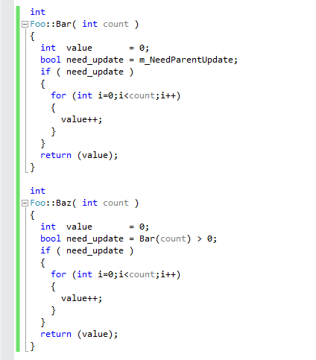
Ghost reads and writes
Don’t re-read member values or re-call functions when
you already have the data.
Hoist all loop-invariant reads and branches. Even super- obvious ones that should already be in registers.

Slide 84
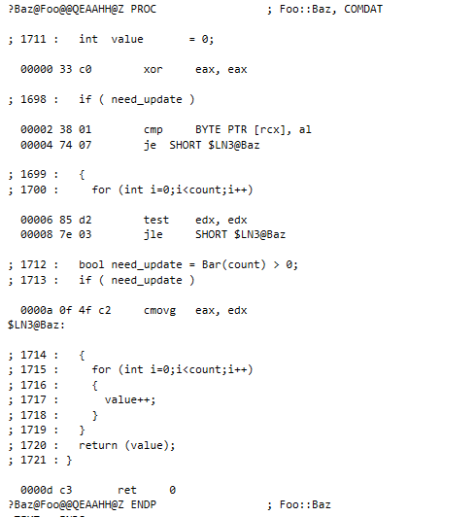
:)

Slide 85
:)
A bit of unnecessary branching, but more-or-less equivalent.

Slide 86
#3 Remove redundant transform redundancy
Often, especially with small functions, there is not enough context to know when and under what conditions a transform will happen.
It’s easy to fall into the over-generalization trap
It’s only real cases, with real data, we’re concerned with.

Slide 87
A little gem…

Slide 88
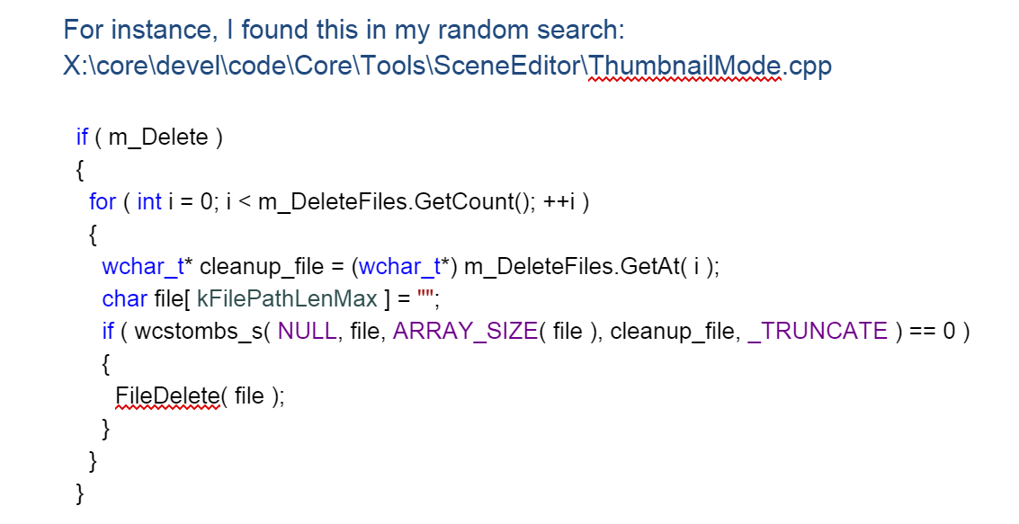

Slide 89
wchar_t* -> char*
Suspicious. I know we don’t handle wide char conversion consistently.

Slide 90


Slide 91
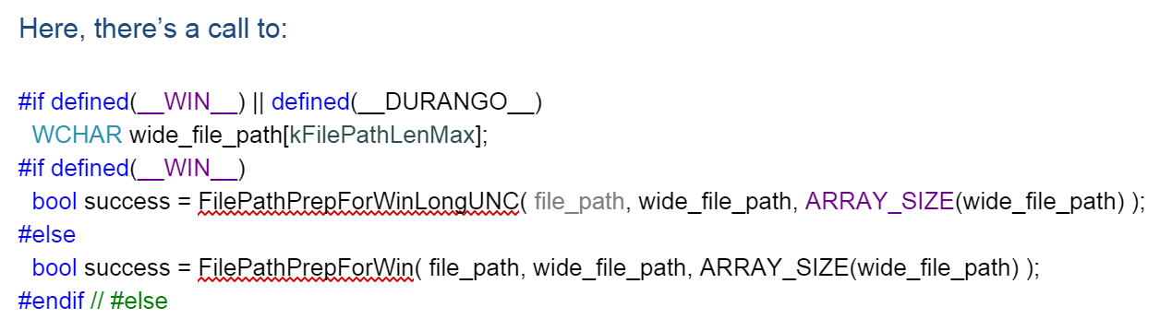

Slide 92
wchar_t* -> char* -> wchar_t*
it takes the char* we created and converts it right back to a whar*

Slide 93
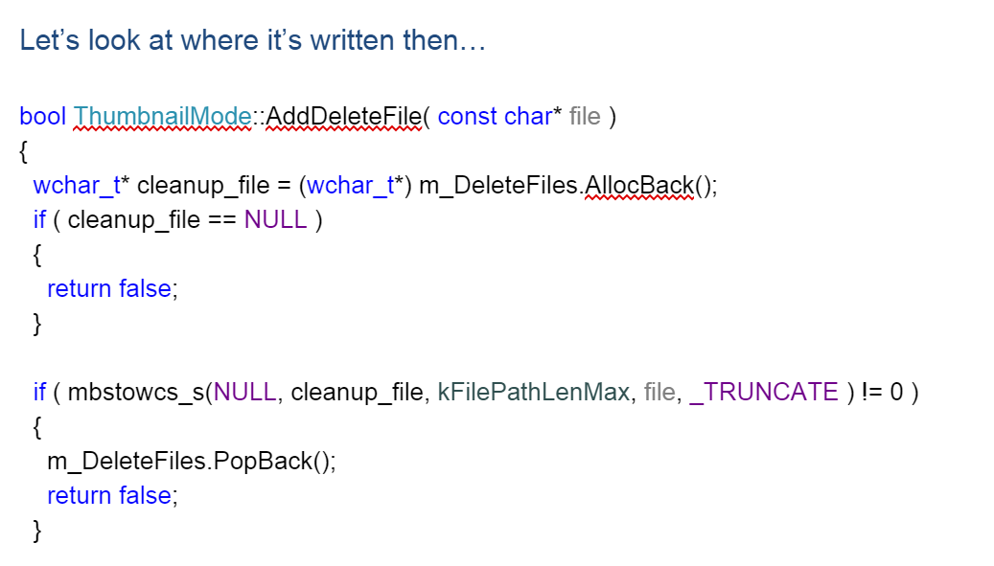

Slide 95
What’s happening?
We convert from char* to wchar* to store it in m_DeleteFiles
…So we can convert it from wchar* to char* to give to FileDelete
…So we can convert it from char* to whcar* to give it to Windows DeleteFile.

Slide 96
Where does the char* come from in the first place?

Slide 97
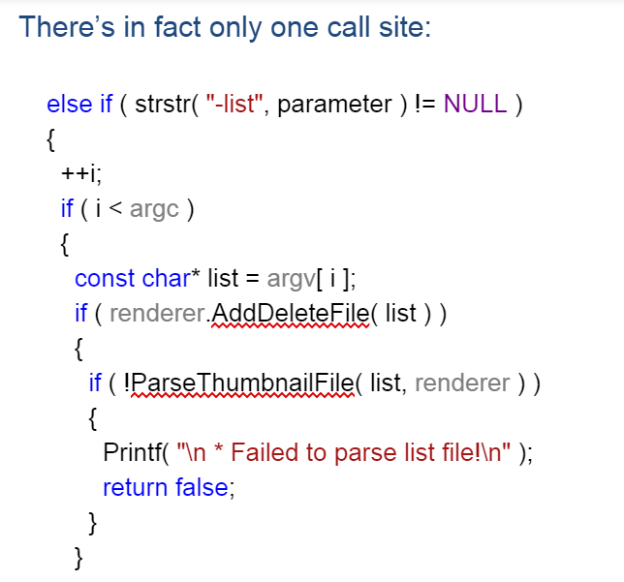

Slide 98
Comes from argv. Never needed to touch the memory!

Slide 99
Which turned out to be a command line parameter that was never used, anywhere.

Slide 100
Which brings us back to the wood carving analogy…

Slide 101
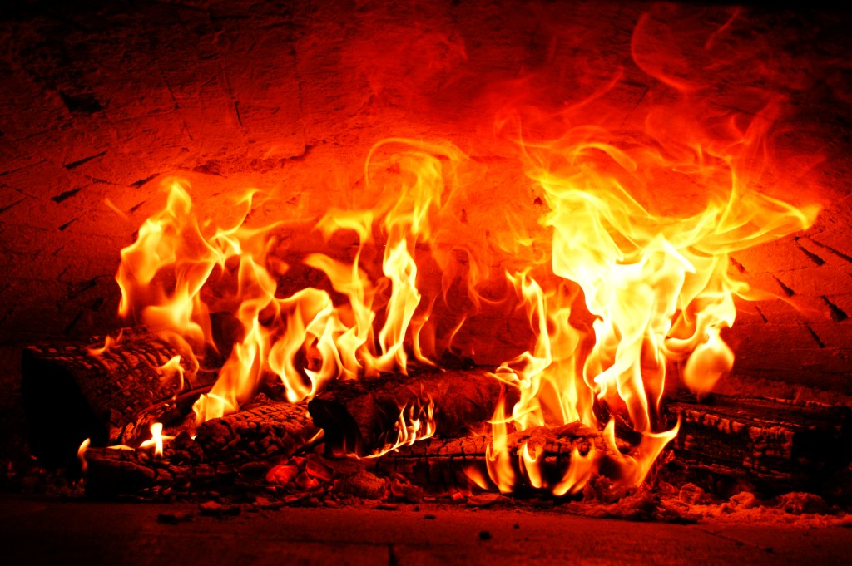

Slide 102
Part 3: Solve details missed by using the tool as intended.

Slide 103
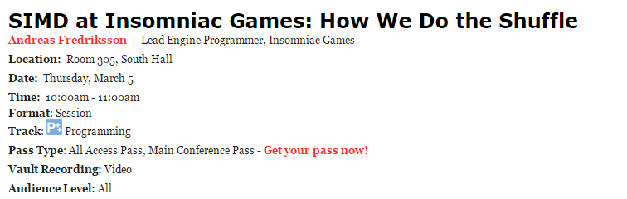
Optimization begins.
See: e.g.

Slide 104
Part 4: Practice

Slide 105
If you don’t practice, you can’t do it when it matters.

Slide 106
Practice
https://oeis.org/A000081

Slide 107

What’s the cause?
http://www.insomniacgames.com/three-big-lies-typical-design-failures-in-game-programming-gdc10/

Slide 108
